Slide 1


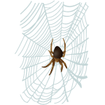
Along Came a Spider:
Exploring the Tangled Web!
Exciting Interest in STEM
via Language Development
Dr. Juanita C. García &
Dr. Rosana G. Rodríguez

Slide 2

Objectives
Excite early inquiry and interest in science through culturally relevant stories, poems and proverbs
Demonstrate connecting content with experiential learning in science
Link science with literacy

Slide 3

Review Science Education Standards
National Science Education Standards
As a result of activities in grades K-4, students should develop the abilities necessary to do scientific inquiry and to understand the process of inquiry.

Slide 4
Why link Science with Literacy?
Underrepresentation of minorities in STEM
Encourage early interest and success in science and language – Science is Everywhere!
Inspire critical thinking skills
Develop scientific inquiry and vocabulary
Encourage oral language and literacy

Slide 5
Process Skills | Science Skills | Language Skills- Oral & Written
Observing | Use of five senses and experiential learning | Develop listening and fluency
Predicting & evaluating (forming an hypothesis) | Create idea of anticipated results Reviewing results | Form ideas of expected events and sequence leading to an outcome
Collecting data | Measure and record data | Incorporate reference data
Investigating | Collect, analyze and report data | Ask questions, investigate, and form conclusions

Slide 6
Process Skills | Science Skills | Language Skills
Interpreting data | Developing and reading graphs | Organizing facts
Classifying | Grouping by types | Sequencing, comparing and contrasting
Forming conclusions | Critical thinking and analysis | Identification and critical analysis of main ideas
Communicating results | Sharing and exchanging information | Oral and listening skills
Adapted from Norman Leonard
nleonard@pike.k12.in.us

Slide 7
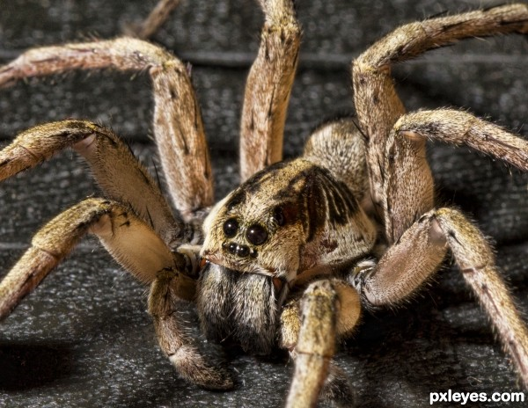
Class Poll Activity
Spiders!!
Are they scary or nice??
Are they helpful or harmful??

Slide 8
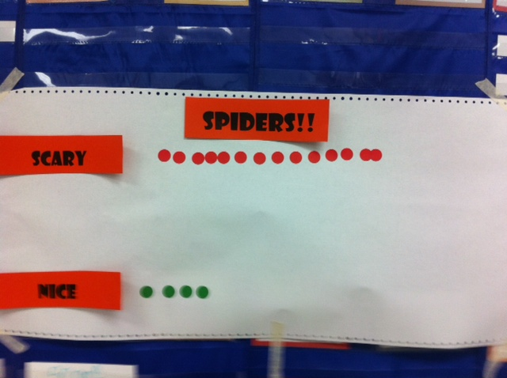

Slide 9
"Oh, what a tangled web we weave,
When first we practice to deceive,
But when we've practiced for a while,
How vastly we improve our style!"

Slide 10

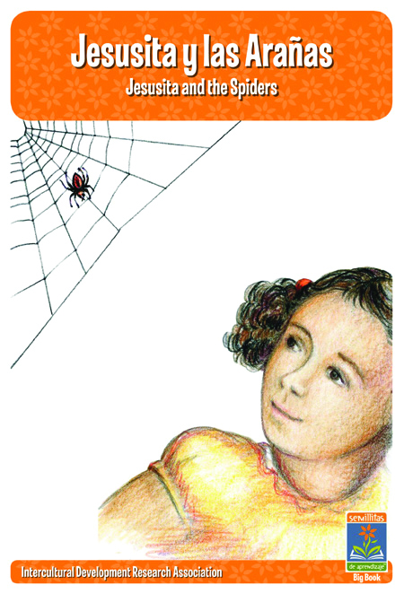
Teatro en el Aula
      Jesusita y las Arañas ~ Jesusita and the Spiders
    Starring…
    Rosana as Narrator and Jesusita
    Juanita as Carmen

Slide 11
Readers Theater
Provides an opportunity for students to develop fluency
Critical factor necessary for achieving reading comprehension
Three possible benefits
  Motivational
  Meaningful context for re-reading
  Group performance fosters engagement

Slide 12
Thinking Like a Scientist Activity
Group memory
  Observe and write
  List individual questions
  Share or borrow
  Formulate one question

Slide 13
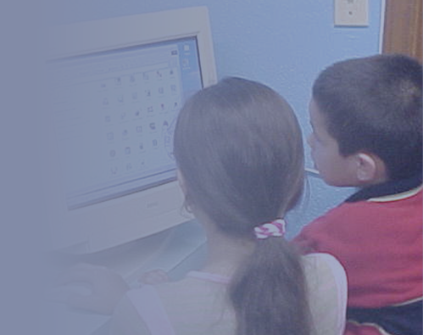
Combining Science and
Language Learning
Both grounded in inquiry
Both develop oral and written language
Both build upon knowledge of the natural world
Both build self-efficacy and expression

Slide 14
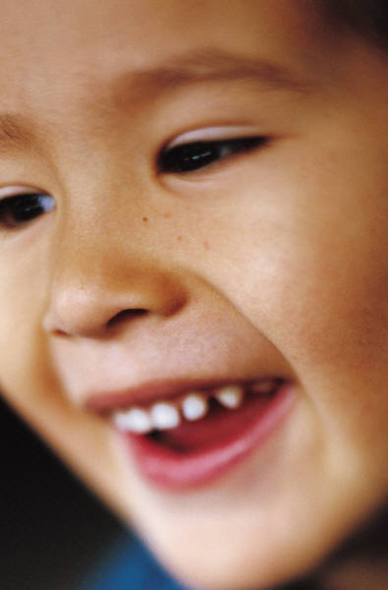
Setting the Stage
What do scientists and writers have in common?
Solve problems through critical thinking
Read, study and write
Pose and investigate questions
Are inspired by history, language and culture and the natural world
Keep notes & journals to research topics
Use all their senses
Share results, observations and outcomes

Slide 15

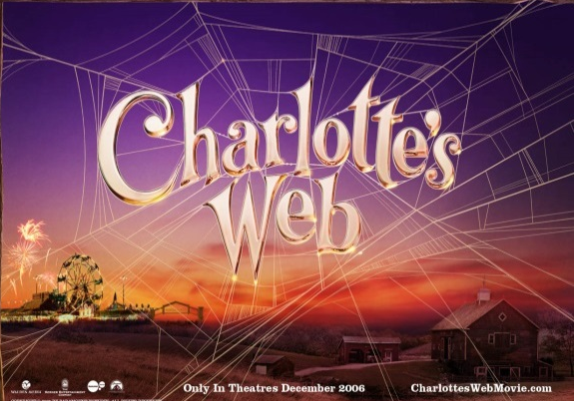
Synthesis
“Remember you don’t fear people whose story you know.”
“You don’t fear creatures if you know their story”

Slide 16
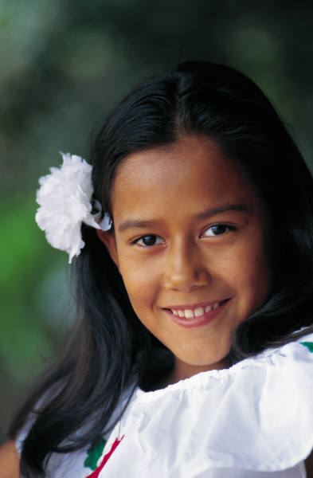
3-2-1 Reflection
3 Things learned
2 Things liked
1 Way to use
Other Thoughts

Slide 17
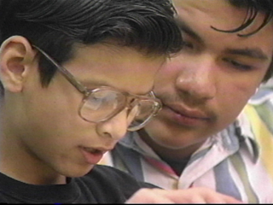
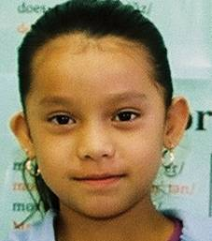
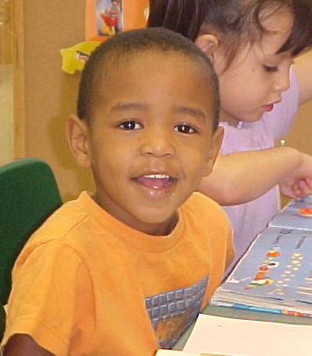
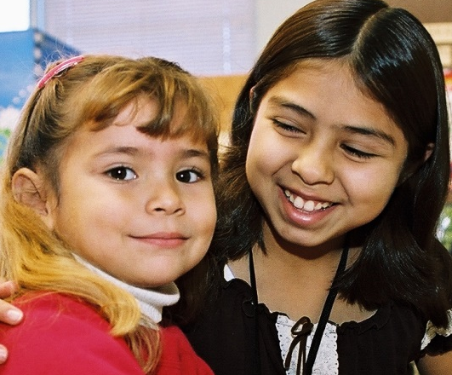
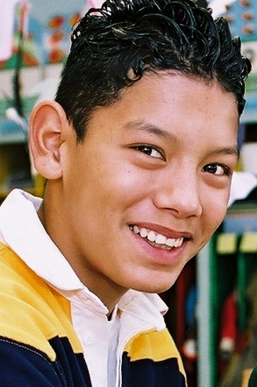






Intercultural Development Research Association
Dr. María “Cuca” Robledo Montecel, President & CEO
5815 Callaghan Road, Suite 101
San Antonio, Texas 78228
210-444-1710 • contact@idra.org
Sign up to receive IDRA news by email at…
www.idra.org
@IDRAedu
pinterest.com/idraedu
facebook.com/IDRAed
www.slideshare.net/ IDRAedu
www.linkedin.com/company/
interculturaldevelopment-researchassociation
flickr.com/
photos/idraedu
Assuring educational opportunity for every child

